Slide 1
Finance Tracker
Prepared By : Pranav and Geetha
Enrollment No: EN12027098860
Enrollment No: EN12027097079
Batch code: DA804S80

Slide 2
INTRODUCTION
A Finance Tracker is a Python application that helps users:
Record income
Record expenses
Store data in CSV files
Generate financial reports
Track monthly spending

Slide 3
OBJECTIVES
Record income and expenses.
Store transactions in CSV files.
Edit and delete transactions.
Generate monthly reports.
Generate category-wise reports.
Calculate income, expenses, and balance.
Apply Python programming concepts.

Slide 4
TECHNOLOGIES USED
Python
Pandas
NumPy
CSV Files
File Handling
Functions
Dictionaries
Classes(Budget class)
Exception Handling
Lists
Loops
Conditional Statements
CSV module
Text file
Groq AI Integration

Slide 5
NumPy Statistics
NumPy is used to calculate:
Mean Expense
Mean Income
Maximum Expense
Minimum Expense
Median Expense
Standard Deviation of Expenses

Slide 6
Testing & Debugging
Test Cases:
Invalid Date
Invalid transaction type
Invalid category
Invalid month format
Invalid numeric input
Empty Input
Empty transaction list
Non-existent transaction deletion
Negative Amount
Large Amount
Invalid Menu Choice
CSV File Missing

Slide 7
Functions Used
Main menu
welcome_menu()
main_menu()
transactions_menu()
add_transaction()
view_transactions()
edit_transaction()
delete_transaction()
category_report()
monthly_report()
income_vs_expense_report()
save_csv()
load_csv()
budgets_menu()
reports_menu()
search_transaction() (if present)
set_budget()
get_budget()
remaining_budget()
numpy_statistics()
AI advisor function()

Slide 8
Main Module (main.py)
Acts as the entry point of the Personal Finance Tracker.
Imports all project modules:
Budget
Transactions
Reports
Data Manager
Loads previously saved transaction and budget data.
Displays the Welcome Menu and Main Menu.
Controls navigation between Transactions, Budgets, and Reports modules.
Validates user input using try-except.
Uses while loops for continuous menu execution.
Uses if-elif-else for menu selection.
Creates the Budget object using OOP concepts.

Slide 9
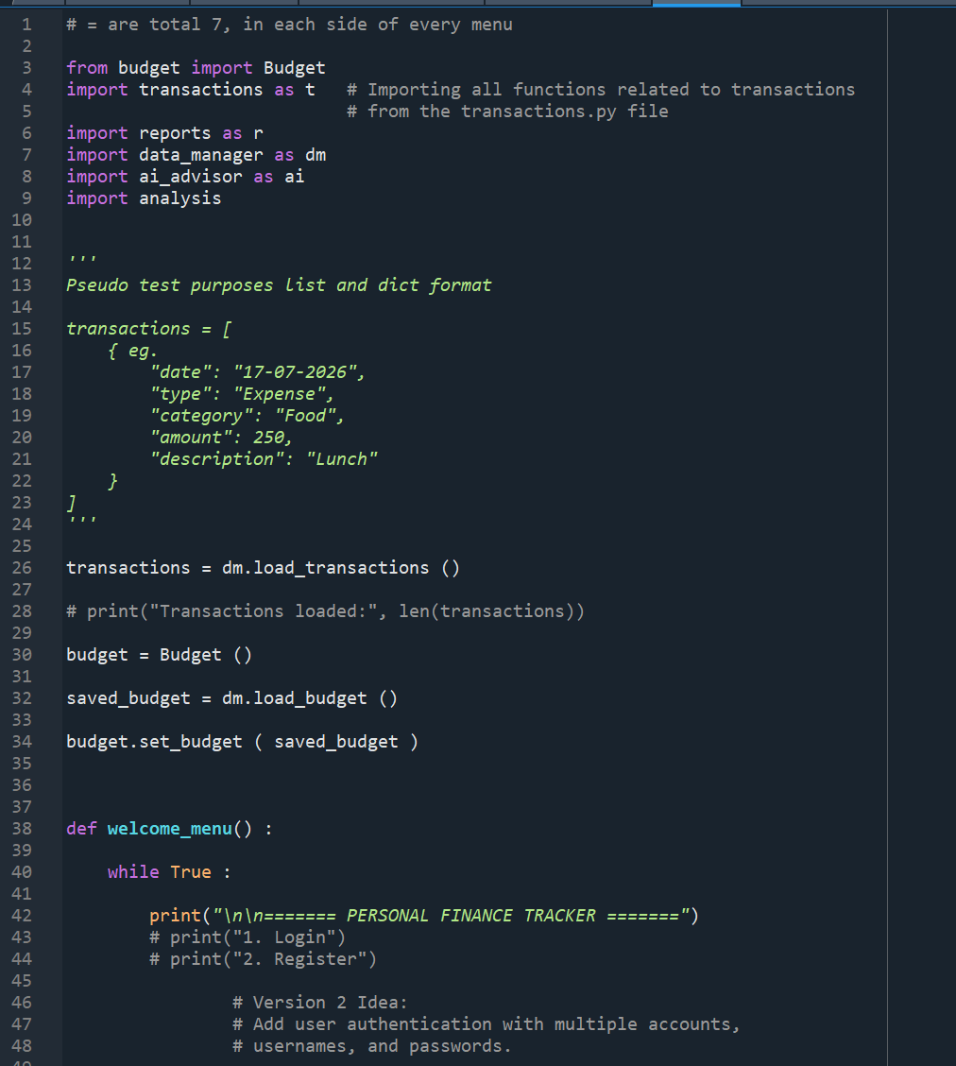
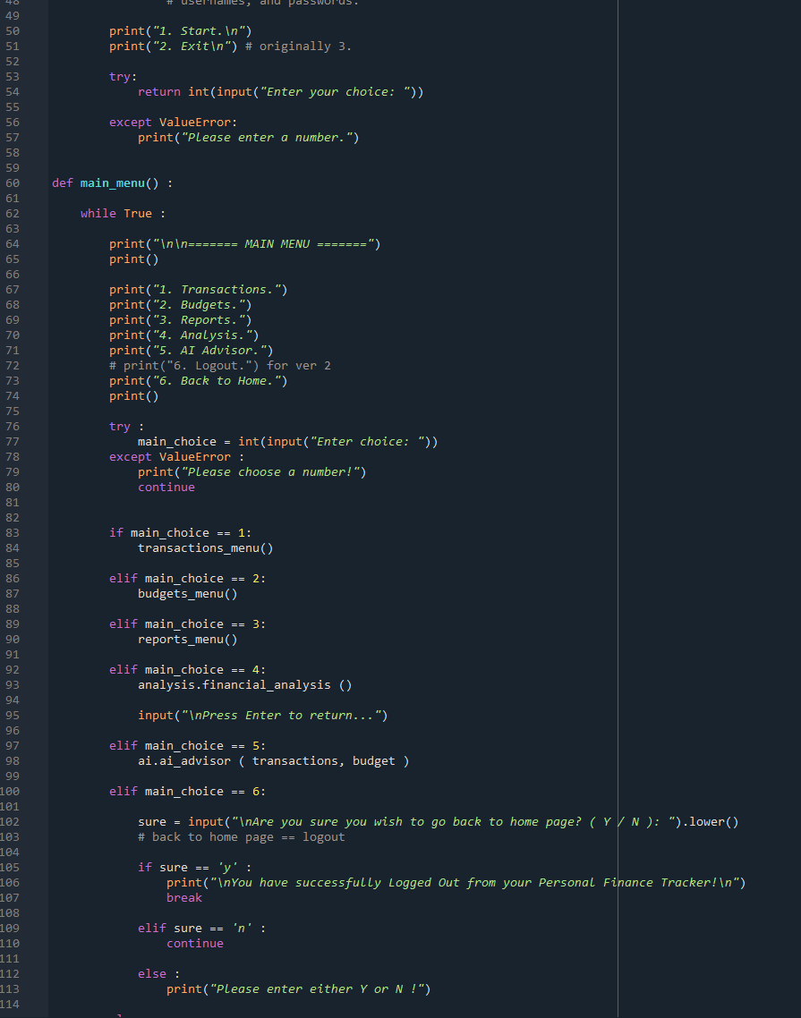

Slide 10
Transactions
Manages all financial transactions (Income & Expense).
Uses functions for Add, View, Edit, and Delete operations.
Stores data using a list of dictionaries.
Validates user input using try-except.
Uses while loops for continuous menu execution.
Uses if-elif-else for menu selection and validation.
Saves updated transactions to CSV using Pandas.

Slide 11
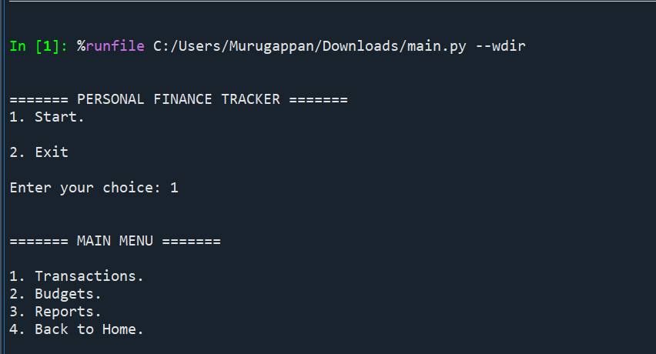
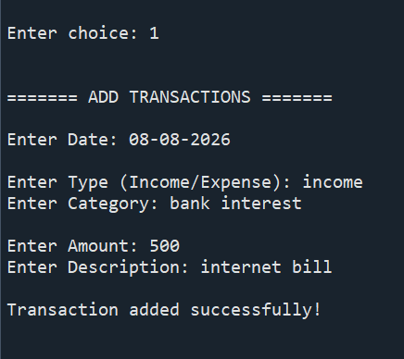
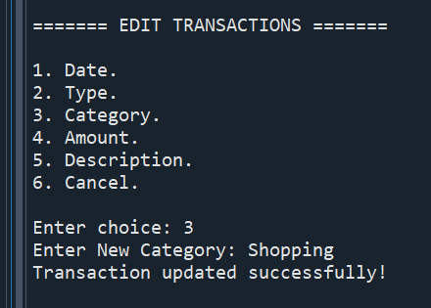
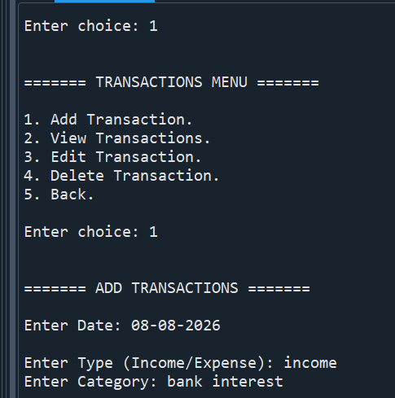
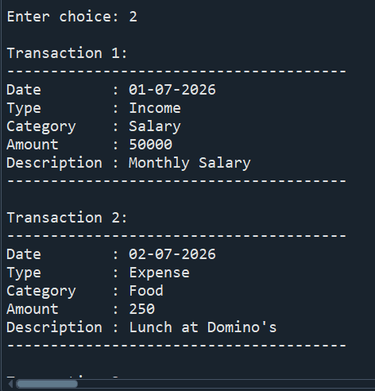
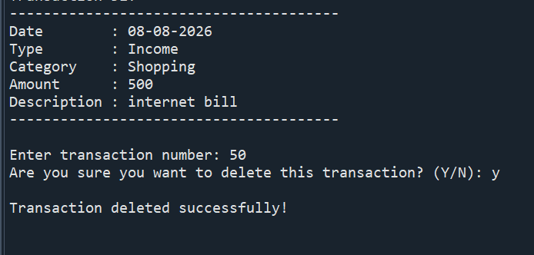
TRANSACTIONS-OUTPUT

Slide 12
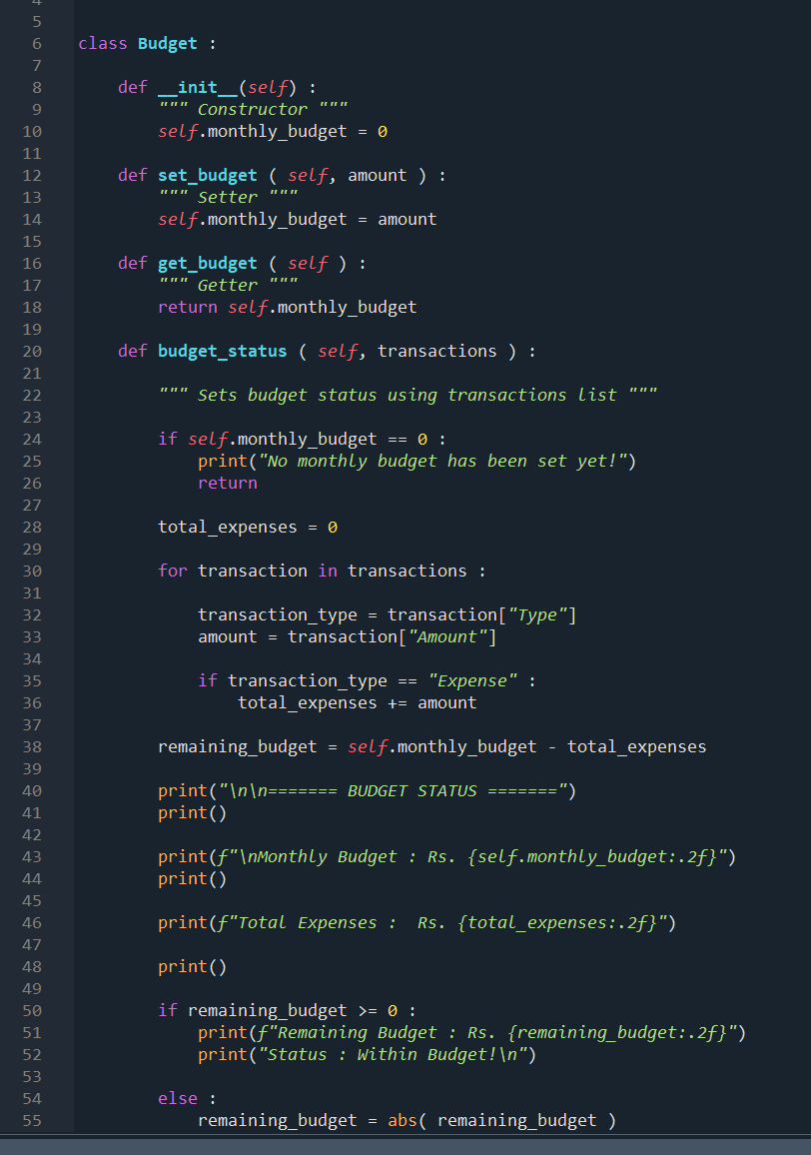
BUDGET
Budget Module
Implements Object-Oriented Programming (OOP).
Uses a Budget class to manage monthly budgets.
Uses Constructor (__init__) for initialization.
Uses Setter method to set the budget.
Uses Getter method to retrieve the budget.
Calculates remaining budget after expenses.
Displays budget status (Within Budget / Exceeded Budget).

Slide 13
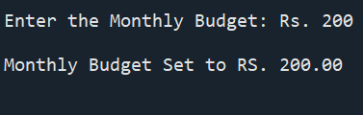
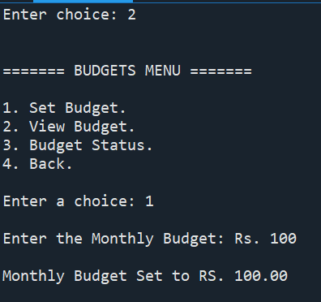
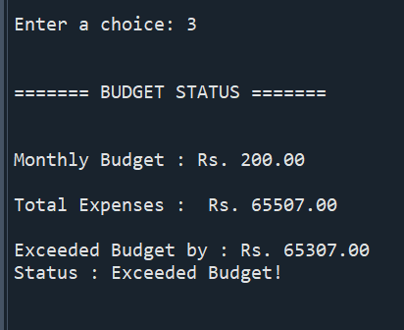
BUDGET OUTPUT

Slide 14
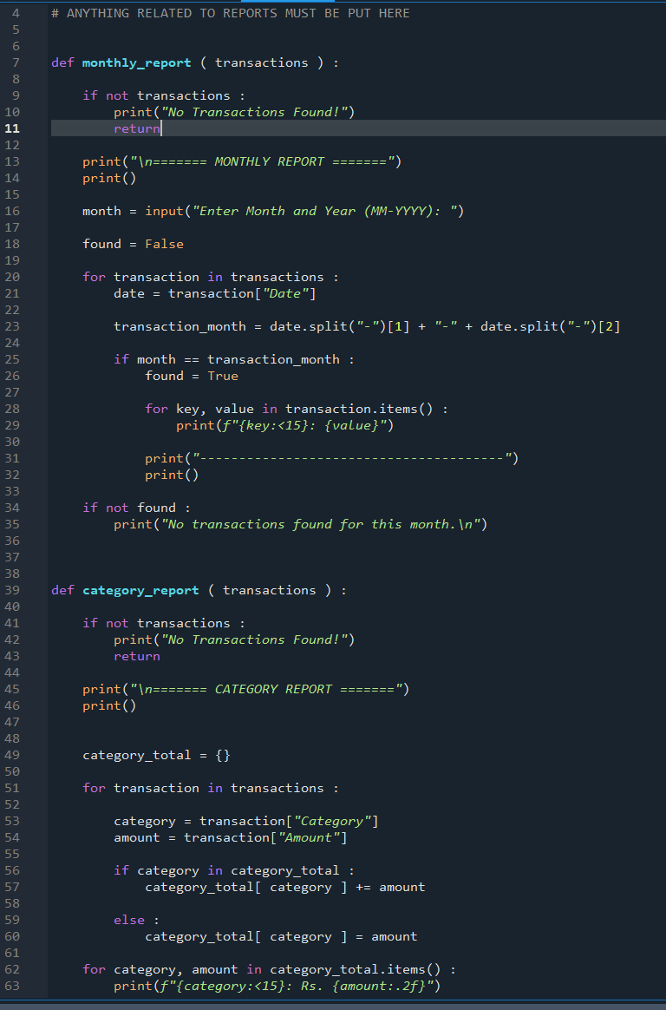
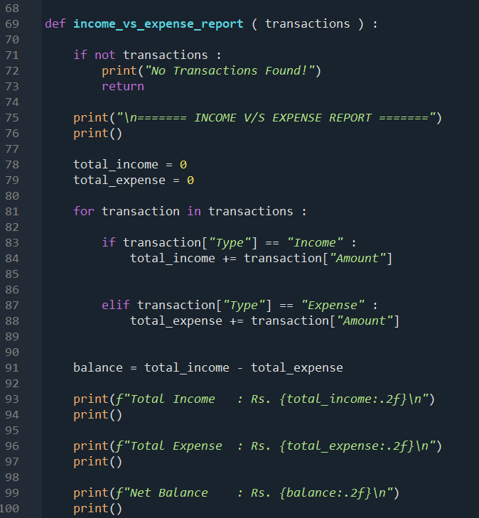
REPORT
Generates financial reports from stored
transactions.
Monthly Report filters transactions by month.
Category Report groups expenses by category.
Income vs Expense Report calculates total income,
expenses, and balance.
Uses loops and dictionaries for report generation.
Displays summarized financial information.

Slide 15
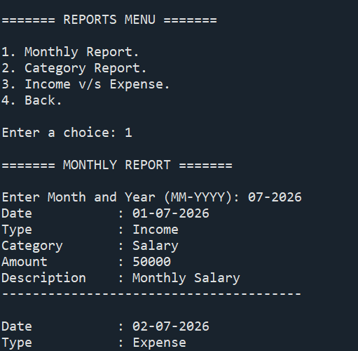
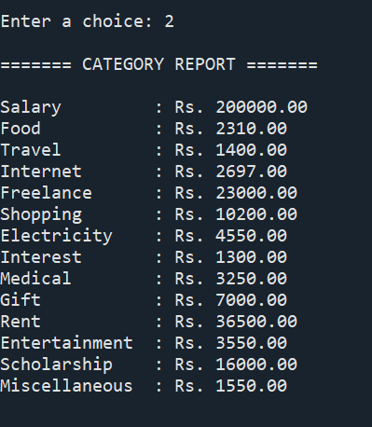
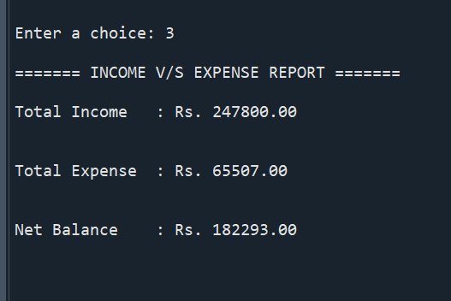
REPORT -OUTPUT

Slide 16
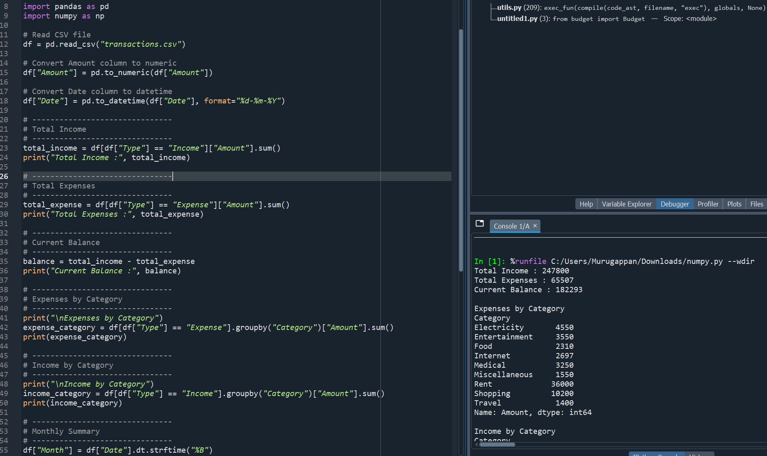
NumPy

Slide 17
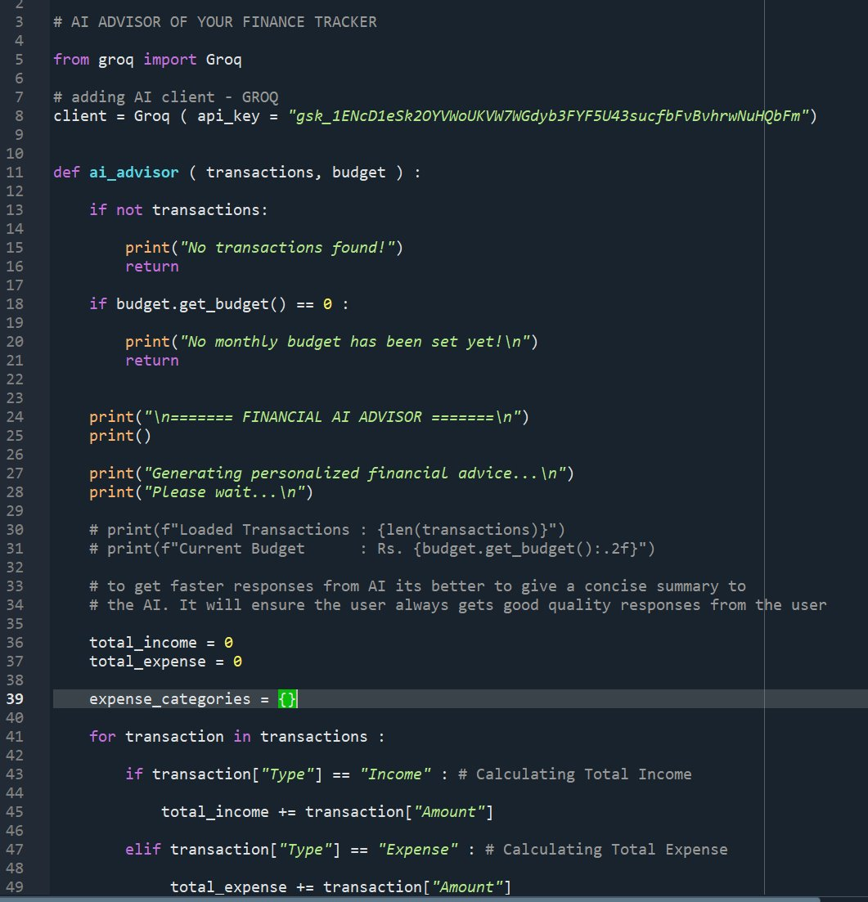
AI Financial Advisor
Uses Groq API
Generates spending insights
Gives budgeting suggestions
Suggests saving opportunities

Slide 18
Conclusion
Statistical Analysis of Profit & Loss
Key Statistics
Total Income: ₹247,800
Total Expenses: ₹65,507
Net Profit: ₹182,293
Profit Margin: 73.56%
Expense Ratio: 26.44%
Interpretation
The Finance Tracker generated a net profit of ₹182,293.
Expenses account for 26.44% of total income.
The remaining 73.56% represents the available profit, indicating healthy financial management.

Slide 19
THANK YOU

